Slide 2
Notes:
A mission in our particular context of space is an operation in which something is being launched out of the Earth’s atmosphere. The missions may be for spacecraft and payloads only, or they can be manned - in other words a spacecraft in which people are traveling. Each mission is given a name, a serial number or word, and for a logo is designed for each mission.
The logo usually includes the names of the persons included in the mission, and the organizations (companies, countries, space agencies) involved in its execution. Each mission’s name is different than any other mission and the logo that is designed for it is different as well.
The mission logo on screen here is an example of the Dragon spacecraft’s first manned mission

Slide 3
Notes:
This is the first (1) mission carried out by AXIOM SPACE (AX)

Slide 4
Notes:
When is the mission scheduled to get underway?
The planned launch date is January 2022

Slide 5
Notes:
To the International Space Station, which is orbiting Earth. It orbits Earth 16 times per day at a speed of more than seven kilometers per second. The Station has been manned continuously since 2000 and is the most valuable object in history.

Slide 6
Notes:
The astronauts on the AX-1 mission will be launched to the Space Station inside a Dragon model spacecraft, borne into orbit on the Falcon launch vehicle. The spacecraft will disengage from the launch vehicle upon its arrival in orbit and will dock with the Space Station after approximately 19 hours after launch.

Slide 7
Notes:
The Space Station is in a state known as “freefall”. It is in fact falling toward Earth and constantly keeps “missing” it. As a consequence, a state called microgravity exists inside the Space Station. In other words, as opposed to Earth, where normal gravity conditions prevail, while inside the Space Station, the sensation is one of a miniscule gravity.
Many materials and processes are affected by these conditions, and they change their behavior, their characteristics, or their function while they are in microgravity. The Space Station is a giant floating laboratory, filled with scientific instrumentation and manned by scientists, and where over 3000 experiments have already been conducted. Its goal is to help expand human knowledge and to contribute toward development and innovation here on Earth and beyond.

Slide 8
Notes:
The AX-1 mission is supposed to carry four people to the Space Station. The mission commander will be Michael Lopez-Alegria, a professional astronaut from the National Aeronautics and Space Administration - NASA, and joining him will be three private astronauts. One of these is Eytan Stibbe, the second Israeli in space.
AX-1 is the first mission in which all the crew members (except for the mission commander) will be private astronauts. A private astronaut is a person who is not an astronaut by profession, in other words his normal occupation is not related to space study or space travel, and that person is funding his flight privately. 7 private astronauts have already visited the Space Station in the past.

Slide 9
Notes:
The mission will last for 10 days
during which the Space Station will be orbiting the Earth 160 times
covering a distance of approximately 700 thousand kilometers

Slide 10
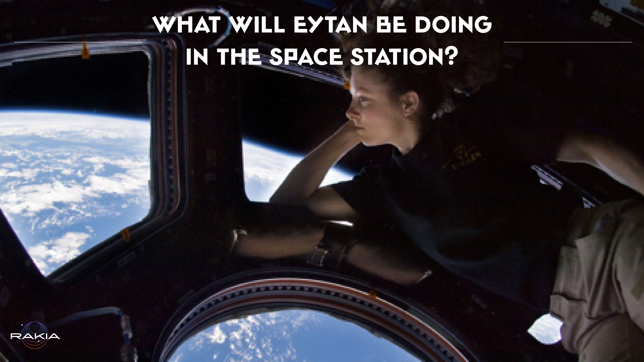
Notes:
He will be able to view 160 sunrises and sunsets, however he will be too busy to be gazing out of the cupola all day. Eytan will be running dozens of experiments, he will be delivering, from his location in Earth orbit, lessons and demonstrations related to science and life in microgravity, which will be attended by hundreds of classes. Thousands of educators and parents will be joining in on the mission helping Eytan engage more and more boys and girls, students of all kinds, so that tens of thousands from all over the country will be taking part before, during and after the mission - in this wonderful adventure mankind is having in space! And you are invited to help decide what Eytan will be devoting his time to in the Space Station, so that more people will be able to be more inspired to go out and make their dreams come true.

