Slide 3
Notes:
Launch vehicles are intended to provide various payloads sufficiently powerful thrust to launch them to the desired altitude above the Earth. The precise altitude they achieve depends on the type of launch vehicle and the designation of the payload. Today we will focus on a launch vehicle intended to carry the spacecraft in which Eytan Stibbe, Israel’s second man in space, will set off on his journey to the Space Station!

Slide 5
Notes:
This launch vehicle is called Falcon 9. Falcon - is a raptor. And the launch vehicle is named Falcon 9 not because there were eight earlier versions of it, but rather because it has nine engines, enabling exceptionally precise control over its velocity and direction.

Slide 6
Notes:
The main parts of the launch vehicle are the engines, the fuel tank - which is the main bulk of the launch vehicle - and its payload attach fitting at the top, to which a payload can be connected and carried beyond the Earth’s atmosphere and deployed at the desired altitude and velocity (depending on the content of the payload

Slide 8
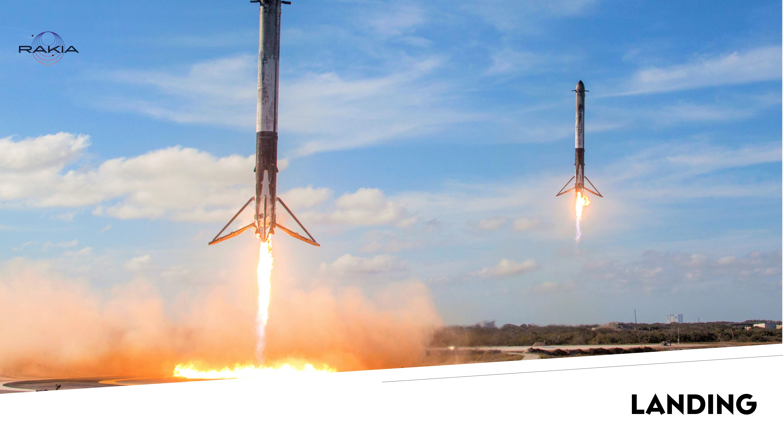
Notes:
Initially the ambition to safely land the launch vehicles seemed to be a virtually unachievable challenge. Totally unrealistic. The number of factors influencing the launch vehicle’s ability to achieve zero velocity precisely at the right moment, at the correct inclination, and in the right place - seemed to be a colossal engineering, mechanical, mathematical and operational task. Do you thing they were successful from the first time?
How Not to Land an Orbital Rocket Booster - YouTube

Slide 9
Notes:
You have five minutes cut the page into its pieces. Prepare the rocket and the straw according to the instructions. Place the target in the intended spot. Try to successfully land your launch vehicle! Document your attempts!

Slide 10
Notes:
Did you notice in the video we have seen that there were many explosions, but almost each one of them happened for a different reason? In the air, when landing, missed the boat, arrived at a bad inclination... Did the same things happen to you in your landing attempts? You tried something slightly different every time. When something worked, did you continue to do that thing until you succeeded?

Slide 12
Notes:
Nowadays the launch vehicles operate routinely and continuously. They are an important link between people on Earth and those beyond it. In January 2022, the Falcon launch vehicle will be carrying the Dragon spacecraft with Eytan Stibbe and other astronauts into orbit around the Earth, and Dragon is going to take them to the International Space Station.
SpaceX - Dragon

